Slide 1

Database Management Systems Lab Database Connectivity
DEPARTMENT OF COMPUTER SCIENCE AND ENGNEERING
INDIAN INSTITUTE OF TECHNOLOGY KHARAGPUR

Slide 2
Database Management Systems Lab
Open Data Base Connectivity (ODBC)
It is an Application Programming Interface(API) that connects an application program to a database
It provides a relatively uniform way for accessing a wide variety of databases such as Oracle, MySQL
Microsoft releases first version of ODBC in 1992
It is written in C language
ODBC 3.0 SDK was release in 1996
Working of ODBC
It inserts a middle layer called a Client Driver
The purpose of the Client Driver is to translate the applications queries into commands that the DBMS understand

Slide 3
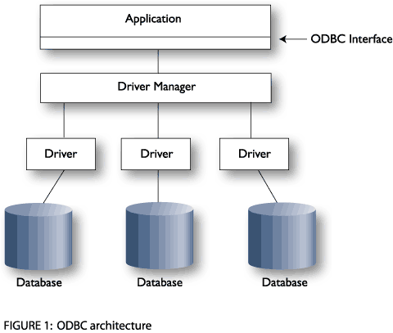
Database Management Systems Lab
Typical Architecture
Application – It calls functions defined in the ODBC API to access a data source
Driver Manager – It implements the ODBC API and provides information to the application
Database – It contains all the data

Slide 4
Database Management Systems Lab
JDBC
Java has defined its own API called JDBC
It uses JDBC drivers which is written in Java language
JDBC-ODBC bridge driver
It converts JDBC method calls into the ODBC function calls
Classes used for Database Connectivity
Driver Manager Class for accessing a particular data source
Connection Class for passing the SQL statements to the DBMS & managing transactions
Statement Class for containing SQL string that are submitted to the DBMS
ResultSet class for providing predefined methods to access, analyze,& convert data values returned by an executed SQL select statement

Slide 5
Database Management Systems Lab
Basic steps to use a database in Java
Establish a connection
import java.sql.*;
Class.forName("oracle.jdbc.driver.OracleDriver");
Connection con = DriverManager.getConnection( "jdbc:oracle:thin:@oracle-prod:1521:OPROD", username, passwd);
Create JDBC Statements
Statement stmt = con.createStatement() ;
Execute SQL Statements
String create = “Create table STUDENT” + “(Roll not null, Name VARCHAR(32),” + “Marks Integer)”;
stmt.executeUpdate(create);
String insert = "Insert into STUDENT values“ +"(123456789,abc,100)";
stmt.executeUpdate(insertLehigh);

Slide 6
Database Management Systems Lab
Basic steps to use a database in Java
GET ResultSet
String query = "select * from Student";
ResultSet rs = Stmt.executeQuery(query);
while (rs.next()) {
int Roll= rs.getInt(“Roll");
String name = rs.getString("NAME");
int marks = rs.getInt("MARKS");
}
Close connections
stmt.close();
con.close();

